Slide 1
HISTORIC YEAR 2019-2023 AND FORECAST TO 2032
GLOBAL ROBOTAXI MARKET
By Vehicle Type: Cars (ICE, BEV, Fuel Cell, Others), Vans (ICE, BEV, Fuel Cell, Others), Other Vehicle Types By Autonomous Level: Teleoperated, Fully Autonomous By Component: Hardware (LiDAR Sensors, Cameras, Radars, Connectivity Modules (5G TCUs), Others), Software By Service: Rental, Station Based By Application: Passenger Transportation, Goods Transportation By Region: North America, Europe, Asia-Pacific, Latin America, Middle East & Africa

Slide 2
MARKET SEGMENTATION
GLOBAL ROBOTAXI MARKET (USD MILLION)
YEARS CONSIDERED :
Historical Year - 2019-2023 | Base Year - 2024 | Forecast Year - 2025-2032
BY VEHICLE TYPE
BY AUTONOMOUS LEVEL
BY COMPONENT
BY SERVICE
BY APPLICATION
Cars
Vans
Other Vehicle Types
Teleoperated
Fully Autonomous
Hardware
Software
Rental
Station Based
Passenger Transportation
Goods Transportation

Slide 3








MARKET TAXONOMY
GLOBAL ROBOTAXI MARKET (USD MILLION)
YEARS CONSIDERED :
Historical Year - 2019-2023 | Base Year - 2024 | Forecast Year - 2025-2032
NORTH AMERICA
EUROPE
ASIA PACIFIC
LATIN AMERICA
MIDDLE EAST & AFRICA
Mexico
GCC Countries
United Kingdom
China
Brazil
Canada
Germany
France
Japan
Spain
South Korea
United States
Italy
India
South Africa
United Kingdom
Germany
France
Spain
GCC Countries
South Africa
Rest of MEA
Italy
Rest of Europe
China
Japan
India
Brazil
Mexico
Rest of LATAM
United States
Canada
South Korea
Rest of APAC

Slide 4
TABLE OF CONTENTS-
GLOBAL ROBOTAXI MARKET-
HISTORIC YEAR 2019-2023 AND FORECAST TO 2032

Slide 5

TABLE OF CONTENTS
1. Introduction | 4.6.1. Competitive Rivalry
1.1. Objectives of the Study | 4.6.2. Threat of substitutes
1.2. Market Definition & Scope | 4.6.3. Bargaining power of buyers
2. Research Methodology | 4.6.4. Threat of new entrants
2.1. Research Process | 4.6.5. Bargaining power of suppliers
2.2. Secondary & Primary Data Methods | 5. Key Market Insights
2.3. Market Size Estimation Methods | 5.1. Key Success Factors
2.4. Market Assumptions & Limitations | 5.2. Market Impacting Factors
3. Executive Summary | 5.3. Top Investment Pockets
3.1. Global Market Outlook | 5.4. Market Attractiveness Index
3.2. Key Market Highlights | 5.5. Market Ecosystem
3.3. Segmental Overview | 5.6. PESTEL Analysis
3.4. Competition Overview | 5.7. Pricing Analysis
4. Market Dynamics & Outlook | 5.8. Regulatory Landscape
4.1. Macro-Economic Indicators​ | 5.9. Case Study Analysis
4.2. Drivers & Opportunitiess | 5.10. Value Chain Analysis
4.3. Restraints & Challenges | 6. Global ROBOTAXI Market Size by Vehicle Type (2025-2032)
4.4. Supply Side Trends | 6.1. Cars
4.5. Demand Side Trends | 6.1.1. ICE
4.6. Porter's Analysis & Impact | 6.1.2. BEV

Slide 6
TABLE OF CONTENTS
6.1.3. Fuel Cell | 9.1. Rental
6.1.4. Others | 9.2. Station Based
6.2. Vans | 10. Global ROBOTAXI Market Size by Application (2025-2032)
6.2.1. ICE | 10.1. Passenger Transportation
6.2.2. BEV | 10.2. Goods Transportation
6.2.3. Fuel Cell | 11. Global ROBOTAXI Market Size by Region (2025-2032)
6.2.4. Others | 11.1. North America (By Vehicle Type, By Autonomous Level, By Component, By Service, By Application)
6.3. Other Vehicle Types | 11.1.1. US
7. Global ROBOTAXI Market Size by Autonomous Level (2025-2032) | 11.1.2. Canada
7.1. Teleoperated | 11.2. Europe (By Vehicle Type, By Autonomous Level, By Component, By Service, By Application)
7.2. Fully Autonomous | 11.2.1. UK
8. Global ROBOTAXI Market Size by Component (2025-2032) | 11.2.2. Germany
8.1. Hardware | 11.2.3. Spain
8.1.1. LiDAR Sensors | 11.2.4. France
8.1.2. Cameras | 11.2.5. Italy
8.1.3. Radars | 11.2.6. Rest of Europe
8.1.4. Connectivity Modules (5G TCUs) | 11.3. Asia-Pacific (By Vehicle Type, By Autonomous Level, By Component, By Service, By Application)
8.1.5. Others | 11.3.1. China
8.2. Software | 11.3.2. India
9. Global ROBOTAXI Market Size by Service (2025-2032) | 11.3.3. Japan

Slide 7
11.3.4. South Korea | 13.1.3. Financial Overview
11.3.5. Rest of Asia Pacific | 13.1.4. Key Developments
11.4. Latin America (By Vehicle Type, By Autonomous Level, By Component, By Service, By Application) | The following companies are listed for indicative purposes only. Similar information will be provided for each, with detailed financial data available exclusively for publicly listed companies.
11.4.1. Brazil | 13.2. Microsoft Corporation
11.4.2. Mexico | 13.3. Google LLC
11.4.3. Rest of Latin America | 13.4. Amazon.com Inc.
11.5. Middle East & Africa (By Vehicle Type, By Autonomous Level, By Component, By Service, By Application) | 13.5. Tesla Inc.
11.5.1. GCC Countries | 14. Conclusion & Recommendation
11.5.2. South Africa
11.5.3. Rest of Middle East & Africa
12. Competitive Dashboard
12.1. Top 5 Player Comparison
12.2. Market Positioning of Key Players, 2024
12.3. Strategies Adopted by Key Market Players
12.4. Recent Developments in the Market
12.5. Company Market Share Analysis, 2024
13. Key Company Profiles
13.1. Apple Inc.
13.1.1. Company Overview
13.1.2. Product Portfolio Overview
TABLE OF CONTENTS

Slide 8
TABLE OF CONTENTS

Slide 9
RESEARCH METHODOLOGY
GLOBAL ROBOTAXI MARKET -
HISTORIC YEAR 2019-2023 AND FORECAST TO 2032

Slide 10
RESEARCH METHODOLOGY
Research Objective
The process begins with clearly defining the research objective, which serves as the foundation for the study. This step identifies the specific goals, questions, or problems the research aims to address.
Research Objective
Secondary Research
Secondary research involves collecting existing data from credible sources to build a comprehensive baseline. This stage gathers relevant insights to contextualize the study and identify data gaps.
Data Modelling
Secondary Research
Data Analysis
Primary Research
Primary Research
Primary research directly gathers first-hand data to validate, complement, or update insights obtained during secondary research. It involves interacting with industry stakeholders to provide real-time insights and market perspectives.
Data Modelling
This step involves using data modeling techniques to forecast future trends and market behavior. Predictive modeling ensures informed decision-making by aligning results with economic, industry, and population metrics.
Data Analysis
Data collected through secondary and primary research is rigorously analyzed to uncover patterns, trends, and actionable insights. This step ensures that findings are relevant, consistent, and aligned with the research objectives
Data Reporting
The findings and insights are compiled into a detailed, well-structured report that aligns with the client's needs and objectives. The report provides actionable recommendations and data-driven conclusions.
Data Reporting

Slide 11

SECONDARY RESEARCH
The purpose of secondary research is to build a solid foundation for understanding the target market by leveraging existing data, reports, and publications. This step is essential to gaining an initial perspective on the market size, trends, competitive dynamics, challenges, and opportunities. Secondary research helps map out broad market insights that can guide further exploration and refinement of the research focus.
Analyst's Role:
Source information from industry reports, government data, trade publications, and online repositories.
Map out the competitive landscape, market challenges, and emerging opportunities.
Highlight data gaps and refine the focus for primary research.
Data Sources
Association and Organization | Research Paper and Journal | Competition Data | Paid Databases | SkyQuest Internal Database
International Association of Public Transport | IEEE Transactions on Intelligent Transportation Systems | Annual Report | Factiva
American Public Transportation Association | Transportation Research Part C: Emerging Technologies | Investor Presentation | Bloomberg
National Highway Traffic Safety Administration | Journal of Intelligent Transportation Systems | SEC Filling/ 10K Sizes | Hoovers
Society of Automotive Engineers | Robotics and Autonomous Systems | Company Website | Morningstar
International Transport Forum | Journal of Field Robotics | Trade Data | Seeking Alpha

Slide 12
PRIMARY RESEARCH
The purpose of executing primary research is to gather firsthand insights that validate and complement the data gathered during secondary research. By directly engaging with market participants, primary research ensures that the findings are grounded in real-world market dynamics. This step provides fresh, up-to-date, and specific information that is essential to gain a more nuanced understanding of the market, uncovering insights that secondary sources may not capture.
Analyst's Role:
Develop interview guides and surveys tailored to the study's objectives
Engage with key industry stakeholders, such as business leaders, end-users, and experts.
Capture a blend of qualitative and quantitative data, ensuring diversity in perspectives.
Break up of Primary Interviews with Industry Experts
BY COMPANY
BY DESIGNATION
BY REGION

Slide 13
EXECUTIVE SUMMARY
GLOBAL ROBOTAXI MARKET -
HISTORIC YEAR 2019-2023 AND FORECAST TO 2032

Slide 14

EXECUTIVE SUMMARY
MARKET OUTLOOK
FIGURE 01. GLOBAL ROBOTAXI MARKET, USD MILLION
The Global ROBOTAXI Market is valued at USD 12 Million in 2024, and is expected to reach USD 12 Million by 2032. The market shows a steady CAGR of 21% from 2025 to 2032. The global Robotaxi market is witnessing substantial growth, driven by advancements in autonomous vehicle technology, supportive government policies, and increasing investment in smart city infrastructure. Key market players include Waymo, Uber, Tesla, Apple, and Baidu, all engaged in competitive research and development. Trends shaping the market include improved lidar sensors, AI technology, and 5G connectivity. However, regulatory hurdles and safety concerns remain significant challenges. The market is set for further expansion with advancements in technology, increasing urbanization, and a growing emphasis on environmentally friendly transportation options. Future prospects demonstrate a shift towards shared mobility and autonomous public transport.
Key Market Enablers
12
Technological Advances: The global Robotaxi market is significantly driven by technological innovations and advancements. Today's Robotaxis are enhanced with features like machine learning algorithms, real-time data capturing, LiDAR, radar, and high-resolution cameras that analyze the environment and drive the vehicle efficiently. Increasing development and incorporation of autonomous driving software, AI, and efficient battery technologies are some of the many technological advancements that are enabling market expansion. Furthermore, key industry players continually invest in R&D activities to improve robotaxi functionalities thereby pushing the market forward. Government Policy and Regulatory Environment: Government support is a vital market enabler for the global Robotaxi market. Governments worldwide are incentivizing or directly funding the development and implementation of autonomous vehicles and AI, perceiving them as a way to reduce traffic congestion, increase transportation efficiency and reduce environmental impact. Moreover, the formulation and relaxation of regulations pertaining to self-driving cars and Robotaxis in several countries is clearing the path for their deployment and commercialization. The support from the regulatory environment is proving to be a strong market enabler, speeding up the realization of the Robotaxi market globally.
12

Slide 15
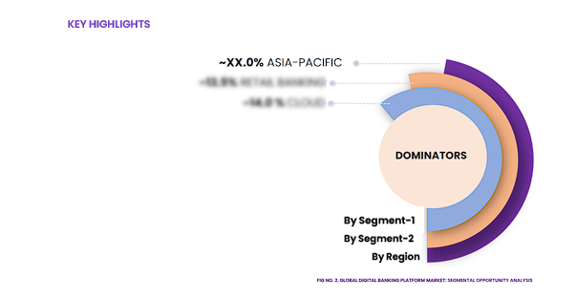
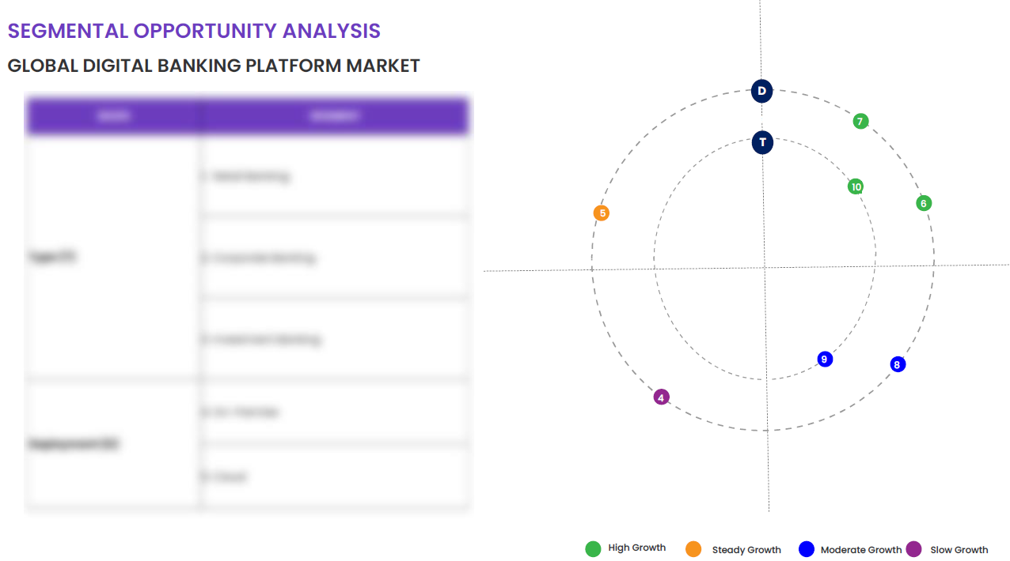
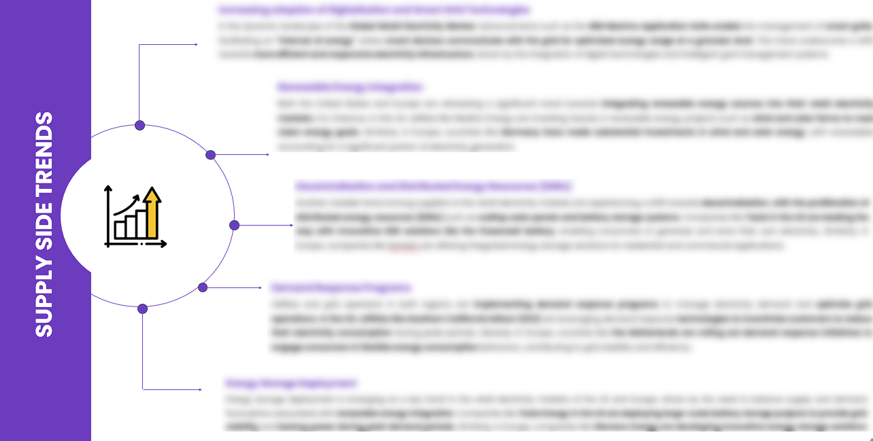
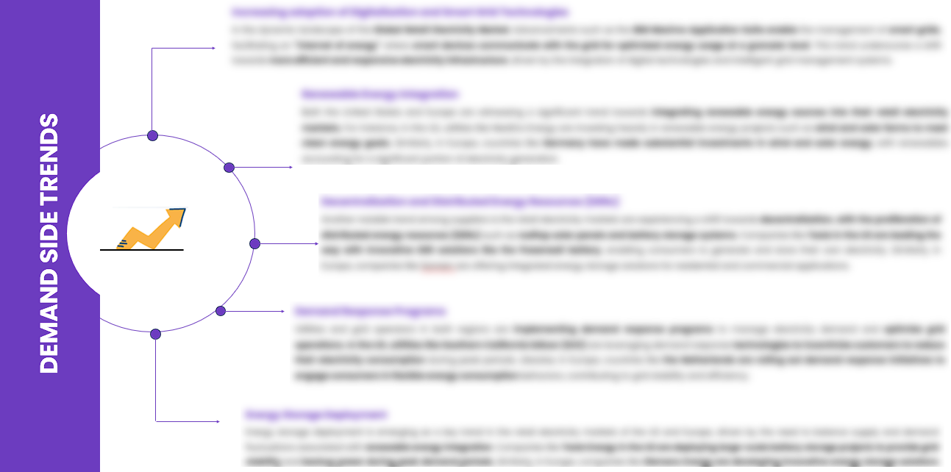
EXECUTIVE SUMMARY
SEGMENTAL OPPORTUNITY ANALYSIS
GLOBAL ROBOTAXI MARKET
GLOBAL ROBOTAXI MARKET,2024
12 MILLION USD
GLOBAL ROBOTAXI MARKET,2032
12 MILLION USD
SUPPLY SIDE TRENDS
DEMAND SIDE TRENDS

Slide 16
MARKET OVERVIEW
Market Drivers & Challenges
Market Attractiveness - Porters Five Analysis
Threat of New Entrants
Bargaining Power of Suppliers
Bargaining Power of Buyers
Threat of Substitute
Intensity of Competitive Rivalry
GLOBAL ROBOTAXI MARKET -
HISTORIC YEAR 2019-2023 AND FORECAST TO 2032

Slide 17
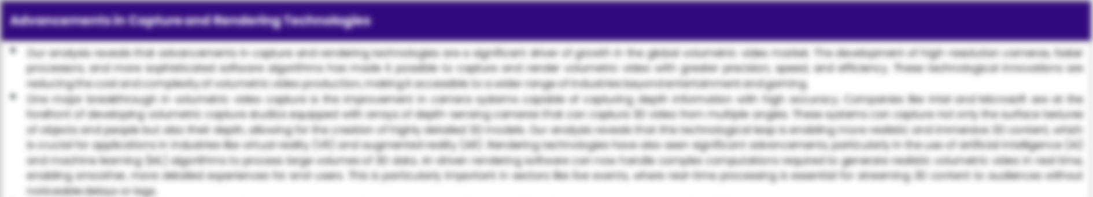
MARKET OVERVIEW: MARKET DRIVERS & OPPORTUNITIES
The rise of the global robotaxi market is driven significantly by leading-edge technological advancements in autonomous vehicle systems. Autonomous vehicles use sophisticated sensors and AI-based systems to perceive their surroundings, interpret that information, and navigate the path to achieve reliable, safer, and more efficient travel in diverse environments. The use of technology involves lidar, radar, GPS, odometry, and computer vision. Autonomous robots operate on pre-determined routes and adapt to real-time information to avoid obstacles, observe traffic rules, and reach their designated location. An example includes Tesla's 'Full Self-Driving' version, which offers a hands-off experience with supervision from the driver. An aspirational push for sustainability also fuels these technological advancements. The majority of robotaxis are electric vehicles, which not only cuts down on harmful emissions but also helps companies meet their sustainability goals. For instance, one of Uber's long-term goals is to have a fully electric fleet in response to growing pressure for green transportation. Furthermore, the aspirations of tech-giants in the convoy of robotaxis, i.e., Google's Waymo and General Motors' Cruise, also hints towards a sustainable route. These companies envision a future where robotaxi networks operate efficiently with renewable energy resources, thereby reducing carbon footprint. With safety as a top priority, tech giants are investing heavily in advanced driver-assistance systems (ADAS) and obstacle detection technology. To illustrate, Waymo’s “driver” system deploys a combination of sensors, including lidar, radar, and cameras, to detect other traffic, pedestrians, and the road ahead, which can perceive objects up to nearly three football fields away, even in the dark. Tesla's advanced 'Autopilot' system uses neural network technology that learns from billions of miles of real-world driving to provide a safe and comfortable ride. Therefore, it is expected that increased technology infusion in the deployment of robotaxis will drive substantial growth in the global market over the forecast period.
Technological Advancements in Autonomous Vehicle Systems

Slide 18
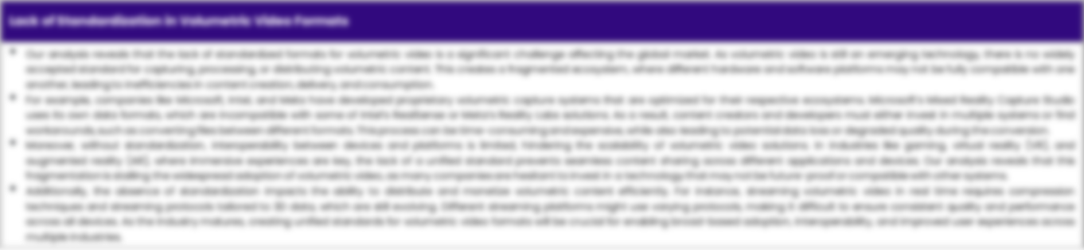
MARKET OVERVIEW: MARKET RESTRAINTS & CHALLENGES
High Initial Investment And Setup Costs Are Posing Challenge To The Growth Of The Market
The exponential growth in the global Robotaxi market is facing potential hurdles by the significantly high initial investment and setup costs. The financial constraints come primarily from developing autonomous driving software, integrating it with customized hardware, and setting up a robust technological infrastructure. Moreover, the expenses further escalate with safety measures, testing, licensing, and compliance with regulatory standards. These factors create significant barriers to entry, discouraging potential players, and limiting market growth. Furthermore, a significant investment is also required in terms of training artificial intelligence and machine learning systems to efficiently navigate various traffic situations. Establishing charging infrastructures and physical depots for maintenance and repair also add to these high initial costs. At the moment, these prerequisites to successful robotic taxi operations are beyond the capacity of smaller companies. Hence, this financial barrier poses a significant challenge to the expansion and innovation within the global Robotaxi market.

Slide 19




MARKET OVERVIEW

Slide 20
KEY MARKET INSIGHTS
Top Investment and White Space Opportunities
Market Ecosystem Mapping
Technological Advancements, Benefits, & Impacts
Market Attractiveness Index, 2024
PESTEL Analysis
Macro-Economic Indicators
Pricing Analysis
Regulatory Landscape
Key Success Factors
Market Impacting Factors
Patent Analysis
Raw Material Analysis
GLOBAL ROBOTAXI MARKET-
HISTORIC YEAR 2019-2023 AND FORECAST TO 2032

Slide 21




KEY MARKET INSIGHTS

Slide 22
GLOBAL MARKET ANALYSIS, SEGMENTAL ANALYSIS
By Vehicle Type, By Autonomous Level, By Component, By Service, By Application
GLOBAL ROBOTAXI MARKET-
HISTORIC YEAR 2019-2023 AND FORECAST TO 2032

Slide 23

GLOBAL MARKET ANALYSIS – BY Vehicle Type
Global ROBOTAXI Market SIZE, BY Vehicle Type, 2019-2023 (USD Million)
Key Takeaways
 | 2019 | 2020 | 2021 | 2022 | 2023 | 2024 | 2025 | 2026 | 2027 | 2028 | 2029 | 2030 | 2031 | 2032 | CAGR (2025–2032)
Cars | XX | XX | XX | XX | XX | XX | XX | XX | XX | XX | XX | XX | XX | XX | XX%
Vans | XX | XX | XX | XX | XX | XX | XX | XX | XX | XX | XX | XX | XX | XX | XX%
Other Vehicle Types | XX | XX | XX | XX | XX | XX | XX | XX | XX | XX | XX | XX | XX | XX | XX%
Total | XX | XX | XX | XX | XX | XX | XX | XX | XX | XX | XX | XX | XX | XX | XX%
*Please note that this slide represents an indicative segmentation overview. the complete level-2 segmentation analysis will be covered in the Final Report.

Slide 24
GLOBAL MARKET ANALYSIS BY REGION
GLOBAL ROBOTAXI MARKET -
Historic Year 2019-2023 and Forecast to 2032

Slide 25


GLOBAL MARKET ANALYSIS BY REGION
Global ROBOTAXI Market: REGIONAL ANALYSIS, 2019-2023 (USD Million)
Key Takeaways
Europe
North America secured the foremost market share at 30.4%, and this dominance is projected to persist through the forecast period. This stronghold is attributed to the region's dense concentration of market competitors and an upsurge in cancer incidence rates. Notably, the U.S. witnessed approximately 1,806,590 new cancer diagnoses in 2020, as reported by the National Cancer Institute. The continuous integration of novel technologies, incorporating artificial intelligence, and the frequent launch of low-radiation CT scans are anticipated to further contribute to the region's market growth.
Conversely, Asia Pacific is poised for noteworthy growth, projected to experience a substantial Compound Annual Growth Rate (CAGR) over the forecast period. This surge can be attributed to the ongoing development of healthcare infrastructure, particularly in burgeoning economies such as India and China. The region's high adoption rate of advanced medical imaging devices, coupled with the increasing prevalence of chronic disorders, further fuels market expansion. Notably, local manufacturers in the region are gaining prominence, bolstering market growth.
North America
APAC
MEA
Latin America
Region | 2019 | 2020 | 2021 | 2022 | 2023 | 2024 | 2025 | 2026 | 2027 | 2028 | 2029 | 2030 | 2031 | 2032 | CAGR (2025-2032)
North America | XX | XX | XX | XX | XX | XX | XX | XX | XX | XX | XX | XX | XX | XX | XX%
Europe | XX | XX | XX | XX | XX | XX | XX | XX | XX | XX | XX | XX | XX | XX | XX%
Asia-Pacific | XX | XX | XX | XX | XX | XX | XX | XX | XX | XX | XX | XX | XX | XX | XX%
Latin America | XX | XX | XX | XX | XX | XX | XX | XX | XX | XX | XX | XX | XX | XX | XX%
Middle East & Africa | XX | XX | XX | XX | XX | XX | XX | XX | XX | XX | XX | XX | XX | XX | XX%
Total | XX | XX | XX | XX | XX | XX | XX | XX | XX | XX | XX | XX | XX | XX | XX%

Slide 26
NORTH AMERICA MARKET ANALYSIS – BY Vehicle Type
NORTH AMERICA GLOBAL ROBOTAXI MARKET SIZE, BY Vehicle Type, 2019-2023 (USD Million)
 | 2019 | 2020 | 2021 | 2022 | 2023 | 2024 | 2025 | 2026 | 2027 | 2028 | 2029 | 2030 | 2031 | 2032 | CAGR (2025–2032)
Cars | XX | XX | XX | XX | XX | XX | XX | XX | XX | XX | XX | XX | XX | XX | XX%
Vans | XX | XX | XX | XX | XX | XX | XX | XX | XX | XX | XX | XX | XX | XX | XX%
Other Vehicle Types | XX | XX | XX | XX | XX | XX | XX | XX | XX | XX | XX | XX | XX | XX | XX%
Total | XX | XX | XX | XX | XX | XX | XX | XX | XX | XX | XX | XX | XX | XX | XX%
Key Takeaways
*Please note that this slide represents an indicative segmentation overview. the complete level-2 segmentation analysis will be covered in the Final Report.

Slide 27
U.S. MARKET ANALYSIS – BY Vehicle Type
U.S. GLOBAL ROBOTAXI MARKET SIZE, BY Vehicle Type, 2019-2023 (USD Million)
 | 2019 | 2020 | 2021 | 2022 | 2023 | 2024 | 2025 | 2026 | 2027 | 2028 | 2029 | 2030 | 2031 | 2032 | CAGR (2025–2032)
Cars | XX | XX | XX | XX | XX | XX | XX | XX | XX | XX | XX | XX | XX | XX | XX%
Vans | XX | XX | XX | XX | XX | XX | XX | XX | XX | XX | XX | XX | XX | XX | XX%
Other Vehicle Types | XX | XX | XX | XX | XX | XX | XX | XX | XX | XX | XX | XX | XX | XX | XX%
Total | XX | XX | XX | XX | XX | XX | XX | XX | XX | XX | XX | XX | XX | XX | XX%
Key Takeaways
*Please note that this slide represents an indicative segmentation overview. the complete level-2 segmentation analysis will be covered in the Final Report.

Slide 28
COMPETITIVE DASHBOARD Top 5 Players Comparison Market Positioning of Key Players, 2023 Strategies Adopted By Key Market Players Recent Development Market Share Analysis, 2023
GLOBAL ROBOTAXI MARKET -
Historic Year 2019-2023 and Forecast to 2032

Slide 29




COMPETITIVE DASHBOARD
Why SkyQuest ?
Global 3D Printing Construction Market Competition Dashboard
The following figure represents the market positioning of Global ROBOTAXI Market players for the year 2023. The market positioning of the leading player is done considering the following points:

Slide 30
COMPETITIVE DASHBOARD
COMPETITORS | Apple Inc. | Company 2 | Company 3 | Company 4 | Company5
Headquarters | Cupertino, California, United States | - | - | - | -
No of Employees | 147,000 | - | - | - | -
Revenue (US$) 2023 | 383.29 | - | - | - | -
Segmental Revenue (US$) 2024 | - | - | - | - | -
Product Overview | - | - | - | - | -
Geographic Presence | worldwide | - | - | - | -
Year of Establishment | 1976 | - | - | - | -
Market Position | - | - | - | - | -

Slide 31
COMPANY PROFILES
GLOBAL ROBOTAXI MARKET -
Historic Year 2019-2023 and Forecast to 2032

Slide 32

Apple Inc. - COMPANY OVERVIEW
COMPANY AT A GLANCE
Established | 1976
Headquarter | Cupertino, California, United States
Ownership | Public
Revenue (US$)- 2024 | 381.6
Employees | 147,000
Website | www.apple.com
OVERVIEW
Founded in 1976 by Steve Jobs, Steve Wozniak, and Ronald Wayne, Apple Inc. is an American multinational corporation that designs and markets consumer electronics, computer software, and personal computers. The company's best-known hardware products include the Macintosh line of computers, the iPod, the iPhone, and the iPad. As of 2020, Apple has nearly 147,000 full-time employees, and maintains 510 retail stores in 25 countries around the world.
PRODUCT OFFERING
PRODUCT NAME | DESCRIPTION
iPhone

Slide 33

Apple Inc. - FINANCIAL OVERVIEW
Apple Inc. - RECENT FINANCIALS IN USD BILLION (2022-2024) | Apple Inc. - BUSINESS REVENUE MIX, 2024 IN PERCENTAGE (%)
SKYQUEST'S TAKE ON THE COMPANY

Slide 34

Apple Inc. – KEY DEVELOPMENTS
DATE | TYPE OF DEVELOPMENT | DESCRIPTION
October 2023 | Partnership | Microsoft and Siemens are deepening their partnership by bringing the benefits of generative AI to industries worldwide. As a first step, the companies are introducing Siemens Industrial Copilot, an AI-powered jointly developed assistant aimed at improving human-machine collaboration in manufacturing. In addition, the launch of the integration between Siemens Teamcenter software for product lifecycle management and Microsoft Teams will further pave the way to enabling the industrial metaverse.
May 2023 | Product launch | Microsoft Corp. announced a suite of new AI solutions and improvements to Microsoft Clumping Clay for Nonprofit that are designed to transform the nonprofit industry and how fundraisers engage with donors, manage campaigns and optimize operations. In addition, the company announced a limited private preview for nonprofits to experience a new AI-powered fundraising propensity model.

Slide 35
ABOUT US & APPENDIX

Slide 36











ABOUT US
Established in 2006, SkyQuest is a Global Market Intelligence, Innovation Management organization that connects innovation to new markets, networks & collaborators for achieving sustainable development goals.
SOME OF OUR CLIENTS
180+ Institutional Clients 125000+ Streaming Clients 500+ Workshops Organized
Sectoral Coverage
| Information Technology | Clean Tech | Marketing & Advertising | Water | Life Sciences and Social | Social | Energy and Power | Food & Beverage | Training & E-Learnings & Materials | Semiconductor & Electronics | Oil & Gas | Banking, Financial, Capital Markets, Insurance

Slide 37
OUR CUSTOMIZED RESEARCH CAPABILITIES
CUSTOMER, DISTRIBUTOR, SUPPLIER INTELLIGENCE
TYPE INTELLIGENCE SUPPORT
Identification of potential partners
Shortlisting/finalization of potential partners
Customer need analysis
Customer's purchase and usage behavior
Customer/partner feedback and satisfaction
Brand perception analysis
Import and Export Intelligence
Commodity pricing intelligence
Product pricing intelligence
Product Positioning Assessment
New product launch tracker
Product claims assessment
Product Concept Testing
COMPETITIVE DASHBOARD SUPPORT
MARKET INTELLIGENCE SUPPORT
Company profiling
Competition assessment incl. market share
Drilled down revenue estimations
Employer value proposition
Market size and segmentation
Growth opportunities
Market dynamics and new developments
Go to Market Strategies
DATA COLLECTION AND ANALYSIS SUPPORT
MARKET STRUCTURE ASSESSMENT
Data analytics and visualization
Data collection, manipulation incl. web scraping
B2B and B2C surveys and interviews
Macroeconomic analysis
Value Chain and Communication Analysis
Regulatory assessment
Coating layer scouting and assessment

Slide 38
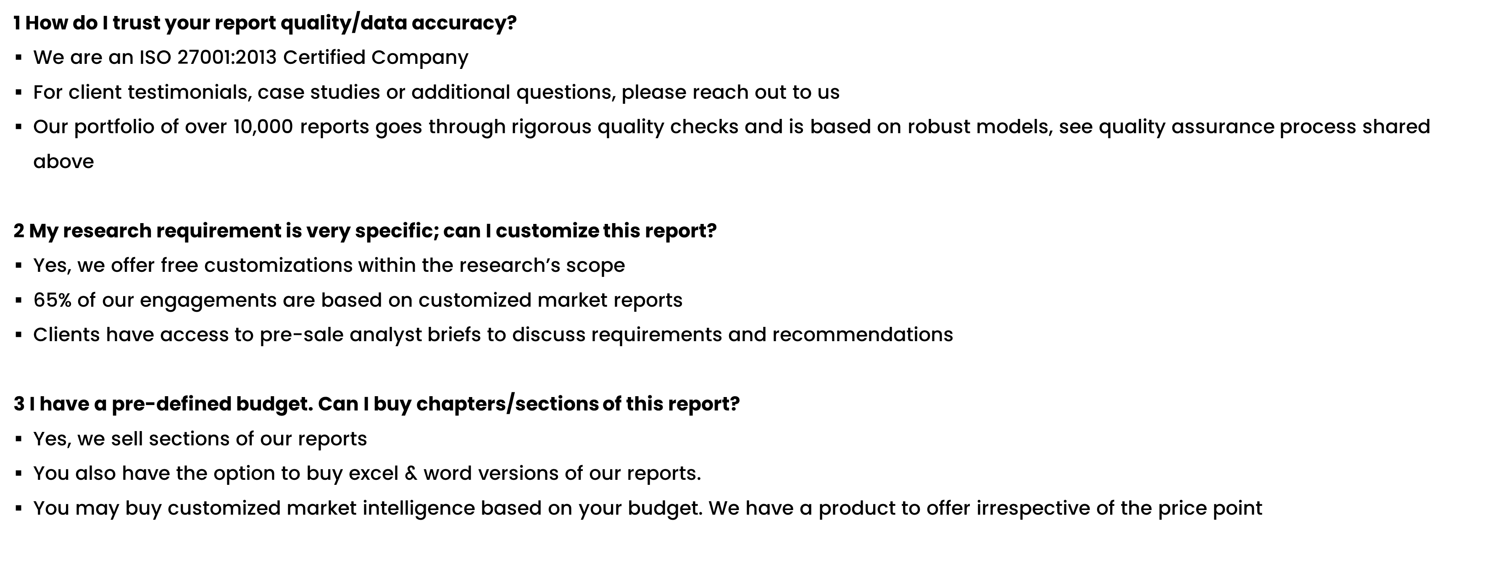
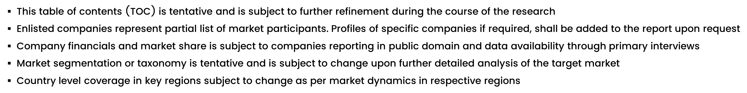
FAQs
NOTE

Slide 39






DISCLAIMER
SkyQuest provides strategic analysis to a select group of customers in response to orders. Our customers acknowledge when ordering that these strategic analysis for internal use and not for general publication or disclosure to any third party. SkyQuest does not endorse any vendor, product, or product type profiled in its publications. SkyQuest's strategic analysis constitutes estimations and projections based on secondary and primary research and are therefore subject to variations.
SkyQuest disclaims all warranties, expressed or implied, with respect to this research, including any warranties of merchantability or fitness, for any particular purpose. SkyQuest takes no responsibility for incorrect information supplied to it by manufacturers or users.
Trademarks, copyrights, and other forms of intellectual property belong to SkyQuest's respective owners and are protected by law. under no circumstance may any of these be reproduced, copied, or circulated in any form, without the prior written approval of SkyQuest's owner-as the case may be no part of this strategic analysis may be given, lent, resold, or disclosed to any third party, without express permission from SkyQuest team.
Reproduction and/or transmission in any form and by any means, including photocopying, mechanical, electronic, recording, or otherwise, without the permission of SkyQuest, is prohibited.
HEADQUARTERS
1 Apache Way, Westford, Massachusetts 01886, United States
APAC OFFICE
Room A & B, 2nd Floor, Lee Kee Commercial Building, 221-227, Queen’s Road Central, Hong Kong
GLOBAL DELIVERY CENTER
D-1001-1005, Swati Clover, Shilaj Circle, Sardar Patel Ring Rd, Thaltej, Ahmedabad, Gujrat-380054
WE ARE REACHABLE AT :-
info@skyquestt.com
+1-617-230-0741
www.skyquestt.com

Slide 40
THANK YOU
www.skyquestt.com

